Slide 1
GPS Location Tracker
Pragna Pulipati (17MIS1044)
Poornima B (17MIS1140)
Beatrix Rubina J (17MIS1154)

Slide 2
Summary
This app helps us to find our current location.
It also uses the external Maps API framework and MapActivity and MapView classes to display Google Maps generated by the Google web services.
It uses location services and LocationManager class to receive information on the device’s position bearing (direction).
It displays the user’s route using an Overlay on a MapView and GPS location data received in the form of Location objects.
It orients a map to the user’s current bearing.

Slide 3
Tools Used
Android Studio
Google maps api

Slide 4
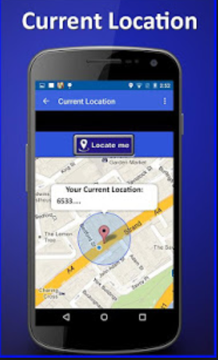
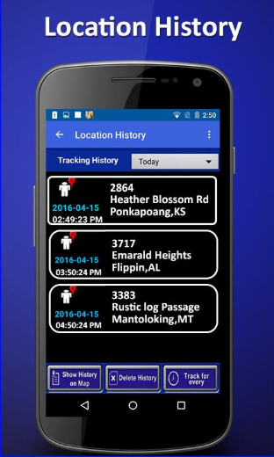
Expected Output

Slide 5
References
ANDROID FOR PROGRAMMERS, AN APP-DRIVEN APPROACH
Deitel Developer Series , (Paul Deitel, Harvey Deitel, Abbey Deitel).
Youtube ( https://www.youtube.com/watch?v=Ak8uRvlpGS0 )
Stack Overflow ( https://stackoverflow.com/questions/43318968/how-to-make-a-simple-tracking-android-app-using-android-studio )

